Slide 1



The SPS Agreement &
Frictionless UK-EU Trade
22nd July 2025

Slide 2



Today’s speaker
Agenda
  Unsworth Introduction
  The new Sanitary and Phytosanitary (SPS) Agreement - the implications for UK/EU trade and how it affects your business.
  Removing post-Brexit trade barriers and driving growth in the EU
Ian Ainslie
International Trade Specialist
iai@unsworth.uk

Slide 3
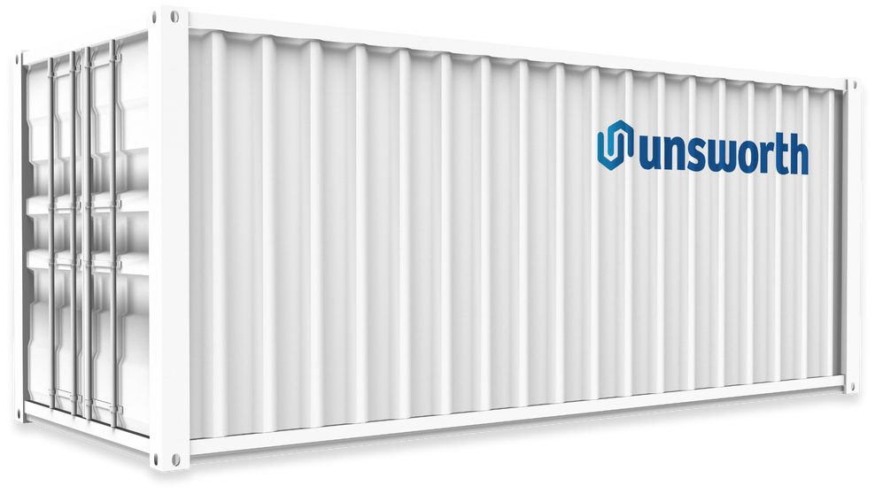
Who are Unsworth?
Unsworth was established in 1974 and has demonstrated 50 years of continued growth as a global freight and supply chain specialist.
We are one of the largest independently owned freight forwarders in the UK with offices in London, Liverpool, Heathrow and Dublin.
We pride ourselves on our expert Customs Solutions and Freight Management teams combined with a robust digitalised process.

Slide 4




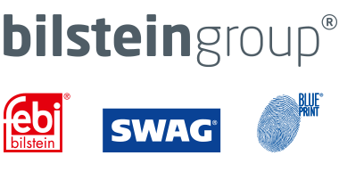








Slide 5


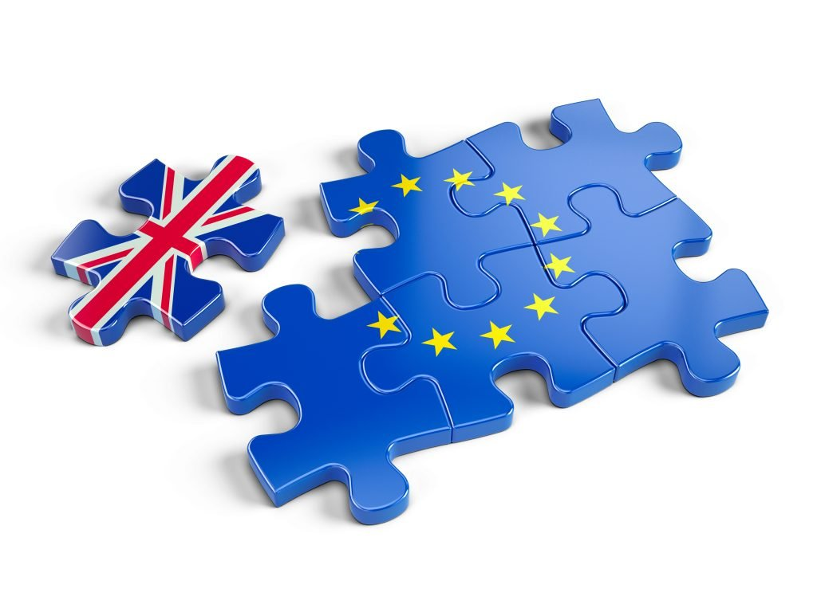
The Impact of Brexit
Since 1st January 2021an Export Health Certificate, Veterinary Inspection and CHED Certificate have been mandatory for exports of UK SPS products to the EU.
UK export declaration and EU import declaration also required
Increased costs for UK companies, loss of business throughout the EU
BTOM phased in from January 31st 2024 for EU to UK SPS products requiring EU businesses to produce

Slide 6
The SPS Announcement
19th May UK Government announced that exploratory talks with the EU had taken place, with a view to strengthening bilateral UK-EU cooperation:
“Renewed agenda for European Union – United Kingdom cooperation Common Understanding”

Slide 7
The SPS Agreement
Section IV “Strengthening our economies while protecting our planet and its resources”
Paragraphs 23 to 33 cover a proposed Sanitary & Phytosanitary Agreement
“Common Sanitary and Phytosanitary Area by way of a European Union-United Kingdom Sanitary & Phytosanitary Agreement”

Slide 8
The SPS Agreement
“This would result in the vast majority of movements of animals, animal products, plants and plant products between Great Britain and the European Union being undertaken without the certificates or controls currently required”
Paragraph 25 :
“The SPS agreement should cover sanitary, phytosanitary, food safety and general consumer protection rules applicable to the production, distribution and consumption of agrifood products”
Paragraph 26 :

Slide 9
Implications
Remove the need for EHC, Vet inspections and CHEDs, thereby reducing costs
Reduced admin burden, faster & more efficient supply chain
Faster time to market for fresh produce
Potential for removal of ban on UK to EU export POAO products (fresh sausages, burgers etc)
Groupage transportation will become financially viable again

Slide 10
Next Steps
Currently no detail provided on timelines or an agreed deadline for implementation
”We will proceed swiftly on the undertakings set out in this document, in accordance with our respective procedures and legal frameworks”
“We affirm our commitment to their full, timely and faithful implementation”

Slide 11
The Impact of Brexit
Significant increase in legislation and red tape involved in selling and shipping goods to Europe since leaving the EU.
Consequent loss of business and market share for UK companies selling to European customers.
Reluctance or lack of knowledge to get involved in customs clearance
Simpler to just buy within the EU – unlevel playing field
Increased costs – the price of getting things wrong at the border as well as EHCs, customs etc

Slide 12

The Solution
Remove the red tape
Remove perceived trade barriers
Remove the customs burden
And make it as easy as possible for lost clients and new prospects alike to say YES to buying from you

Slide 13
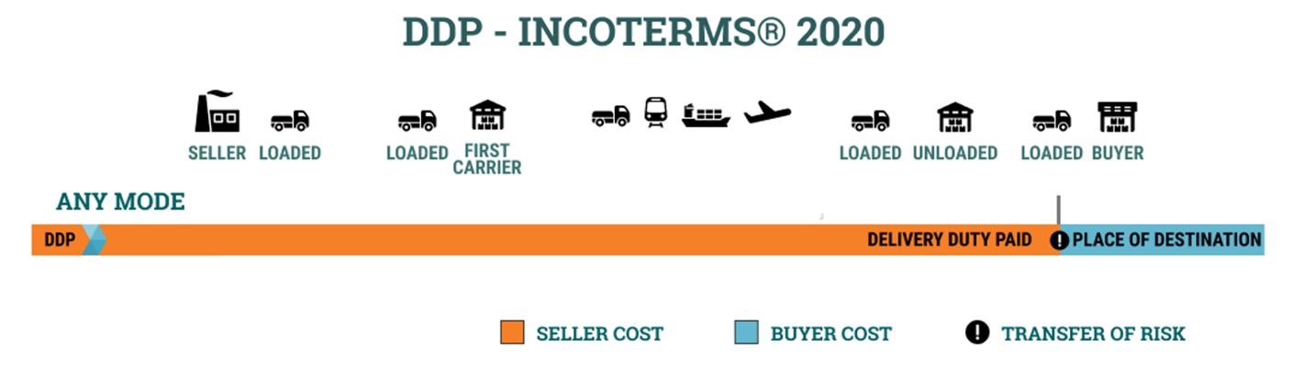
DDP - Removing The Burden
Under Delivered Duty Paid (DDP) Incoterms, the Seller acts as both exporter and importer.
You define where and how customs clearance takes place
You remove the customs burden – customers are no longer involved in the process

Slide 14

Why DDP?
Selling to your European customers using DDP incoterms
offers multiple benefits.
Smoother logistics, customs clearance and inspections for POAO & composite goods
Reduced Supply Chain spend
Simplified and enhanced EU sales process
Zero Import VAT payable

Slide 15
Smoother Logistics & Clearance
Single Point of Entry
With DDP you can use Calais as the single point of entry to the EU, no matter where your clients are in Europe.
Stop Once, Not Twice
Vet inspection & customs clearance are streamlined through a single point of entry and simultaneously managed by a single import broker.
This makes for faster, more efficient shipping.
Free Circulation
When cleared, your goods are in free circulation throughout the EU. There’s no need to deal with customs officials at multiple border points, as everything is completed in Calais.

Slide 16

Reduce Costs
DDP removes cost of the T1
You clear in Calais, so there is no need for a T1 Transit document.
Reduced risk of demurrage
You take control of clearance at Calais and no longer rely on your client’s broker. Problems at the BCP are dealt with swiftly by a team of experienced POAO professionals.
Reduced freight costs
Your haulier drives directly to the destination without the need to divert to a customs point on route to discharge a T1.

Slide 17
Enhanced & Simplified Sales
Best Buying Experience
DDP offers the easiest way for your EU customers to buy from you.
The trailer arrives and they offload the goods. That’s it!
Compete on Equal Terms
DDP levels the playing field with your EU competition. It removes the risk of customers sourcing similar product from your EU competition, so that they can avoid involvement with customs, inspection, Duty/VAT etc.
Rebuild & Grow
Offers the opportunity to rebuild lost EU market share with customers that took their business elsewhere in Europe, as they wanted a simpler solution.

Slide 18

Zero Import VAT & Improved Cashflow
Shipping as DDP and managing customs clearance through France means that all import VAT is auto liquidated on entry - there is nothing to pay at any point in the process.
Your clients’ vital cashflow is no longer tied up in the VAT payment cycle, which makes you a more attractive partner to do business with over suppliers that don’t offer DDP.

Slide 19
Next Steps
Both a French VAT and an EU EORI number are required to facilitate customs clearance through France under DDP terms.
The acquisition process is simple and well documented:
Rent Existing French VAT
Acquire Full French VAT number
Acquire EU EORI – can be any EU state, not specifically France
No need to set up a physical entity in the EU, the French VAT number is registered against your existing UK entity

Slide 20
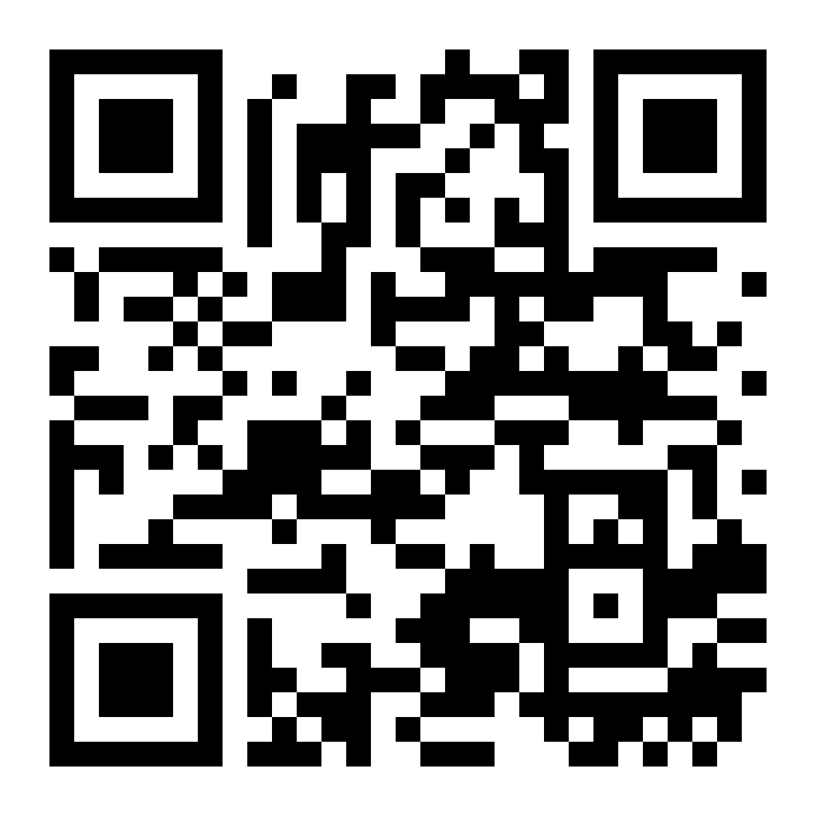
Don’t Miss Out

Slide 21

Contact Us
Ian Ainslie
International Trade Specialist
iai@unsworth.uk
www.unsworth.uk
07899 703 686

